Slide 1
Before we start… following the introduction lesson (This slide will be an exercise for the intermediate group)
In the last exercise you opened up a new R project
R projects are a good practice, but why is that? answer the following questions
Explain why analysis should save scripts rather than environments.
Explain what a working directory is.
Why is setwd() a bad idea to use in your scripts?
Explain the difference between an absolute path and a relative path
3 minutes

Slide 2
Syntax, functions, loops, and data types
March 2019

Slide 3




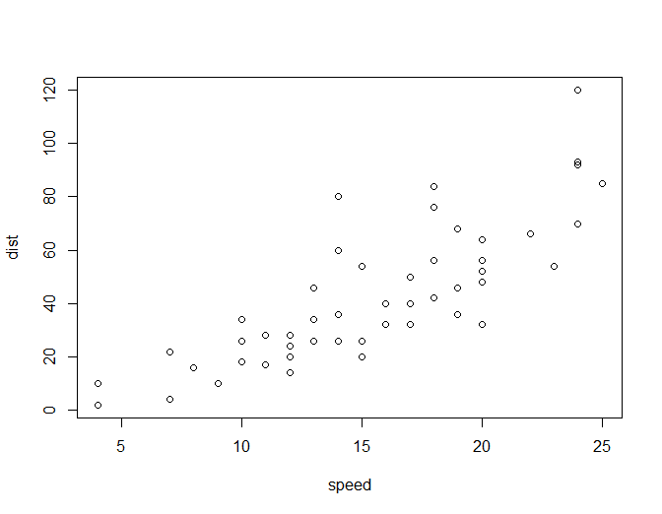

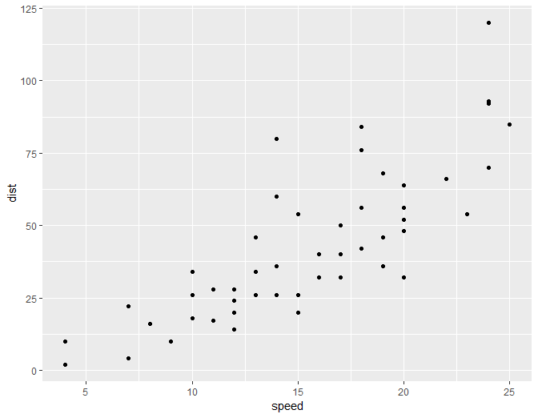
Syntax types
What we’re going
to focus on today
Loops
(for, while)
Functional programming
Base-
Syntax types
Functions, conditionals (if)
Base plots
Data types

Slide 4
A short quiz, in pairs
Name the 4 main base-r data types
Bonus if you can get that up to 6
Novice: you can guess by previous experience (e.g., with R or other programming languages or just general knowledge)
Intermediate: you should probably know this already…

Slide 5
Character (string)
Integer
Numeric
Logical (Boolean)
POSIX (date)
factor
Answers will appear here after click

Slide 6
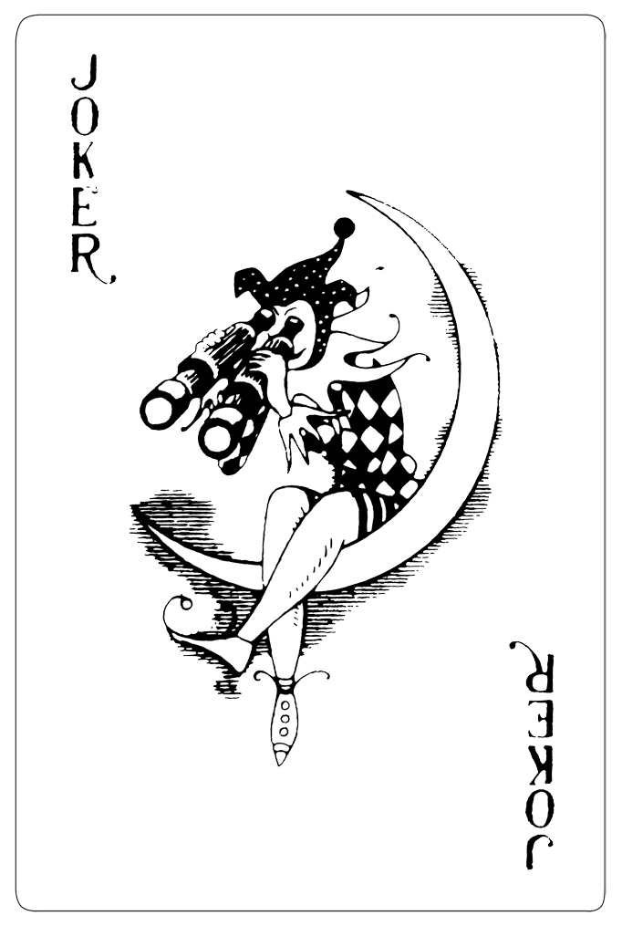
How data types work?
The basic data types can join together to form more complex structures such as: vectors, data.frames, matrix, or even more complex structures called lists
You will cover most of these in the next exercise
Vector:
Matrix:
Data frame:
num | date | fact | num2 | logi
Lists: an arbitrary combination

Slide 7
The missing value (“NA”)
NA is short for Not Available (or not applicable).
Objects in R can have NA as a value, e.g., a vector like c(1, 2, NA, 10, 3).
This happens a lot with data.
Can you guess what the following will yield?
NA + 1
NA * 1
NA * 0
NA ^ 0
is.na(NA)
Using R’s console check if you were right. Can you explain this behavior?
2 minutes

Slide 8
Inf, -Inf, NaN, NULL,
R can work with infinite values Inf, -Inf
What are they useful for?
NaN is Not a Number (i.e., log(-Inf), Inf*0)
NULL is a null value, it can be used to initialize variables, or used as a return value for functions when they fail or yield no other result
A set of base-r functions can help us handle these special values:
is.na
is.finite
is.infinite
is.null
is.nan

Slide 9
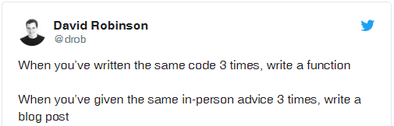
How functions work?
A function is code you write once when you want to use it many times perhaps with some variations. For example:
oneplus <- function(number){
new_number <- number + 1
return(new_number)
}
oneplus(1)
oneplus(oneplus(1))
function definition
function usage

Slide 10
Iterations (loops) Which of the following are iterations?
Try to run them in an R Script and see what their output is
a <- 0
while (a < 100){
a <- a+1
}
library(purrr)
map_dbl(1:100, function(a){a+1})
a <- 0
for (i in 1:10){
a <- a+1
}
a <- 1:100
a <- a + 1

Slide 11
Iterations (loops) Which of the following are iterations?
Try to run them in an R Script and see what their output is
Answers will appear here after a click
a <- 0
while (a < 100){
a <- a+1
}
library(purrr)
map_dbl(1:100, function(a){a+1})
Base R loop
purrr iteration C++ loop
a <- 0
for (i in 1:10){
a <- a+1
}
a <- 1:100
a <- a + 1
core vector operation (C loop)
Base R loop

Slide 12
Conditionals (if…else if…else)
Check a condition and decide what code should run
Very useful from within functions
a <- 1:10000
if (length(a)<100){
cat("a is a short vector")
} else if (length(a) < 1000) {
cat("a is a medium sized vector")
} else {
cat("a is a long vector")
}

Slide 13
Time for some exercise
Open “01-Syntax, functions, loops, data types.Rmd” and start the exercise.

Slide 14
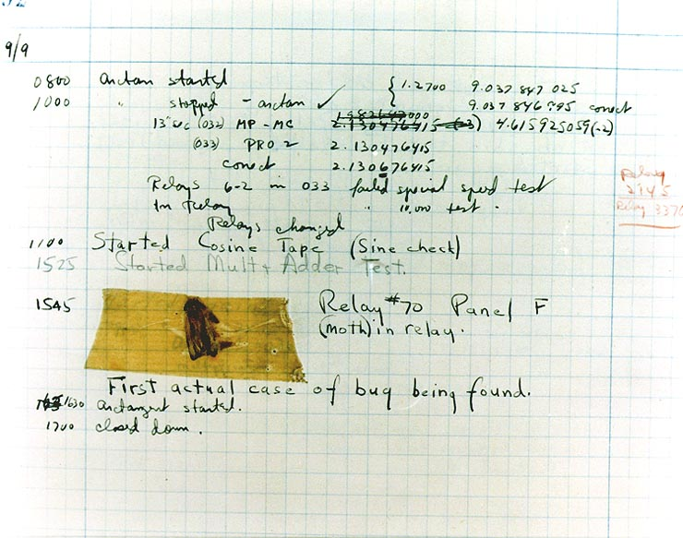
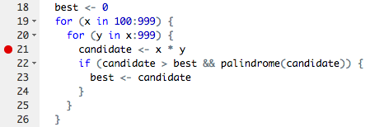
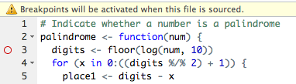
Debugging
wikipedia: software bug
A bug is an error which makes your program/function crash or to not work properly
Sometimes, bugs are hard to identify and to locate
RStudio has some built-in tools to help us debug our code
Editor break points, next, step-in functions and continue
Realize you have a bug
Make it repeatable (reprex)
Figure out where it is
Fix it and test it

